Slide 1
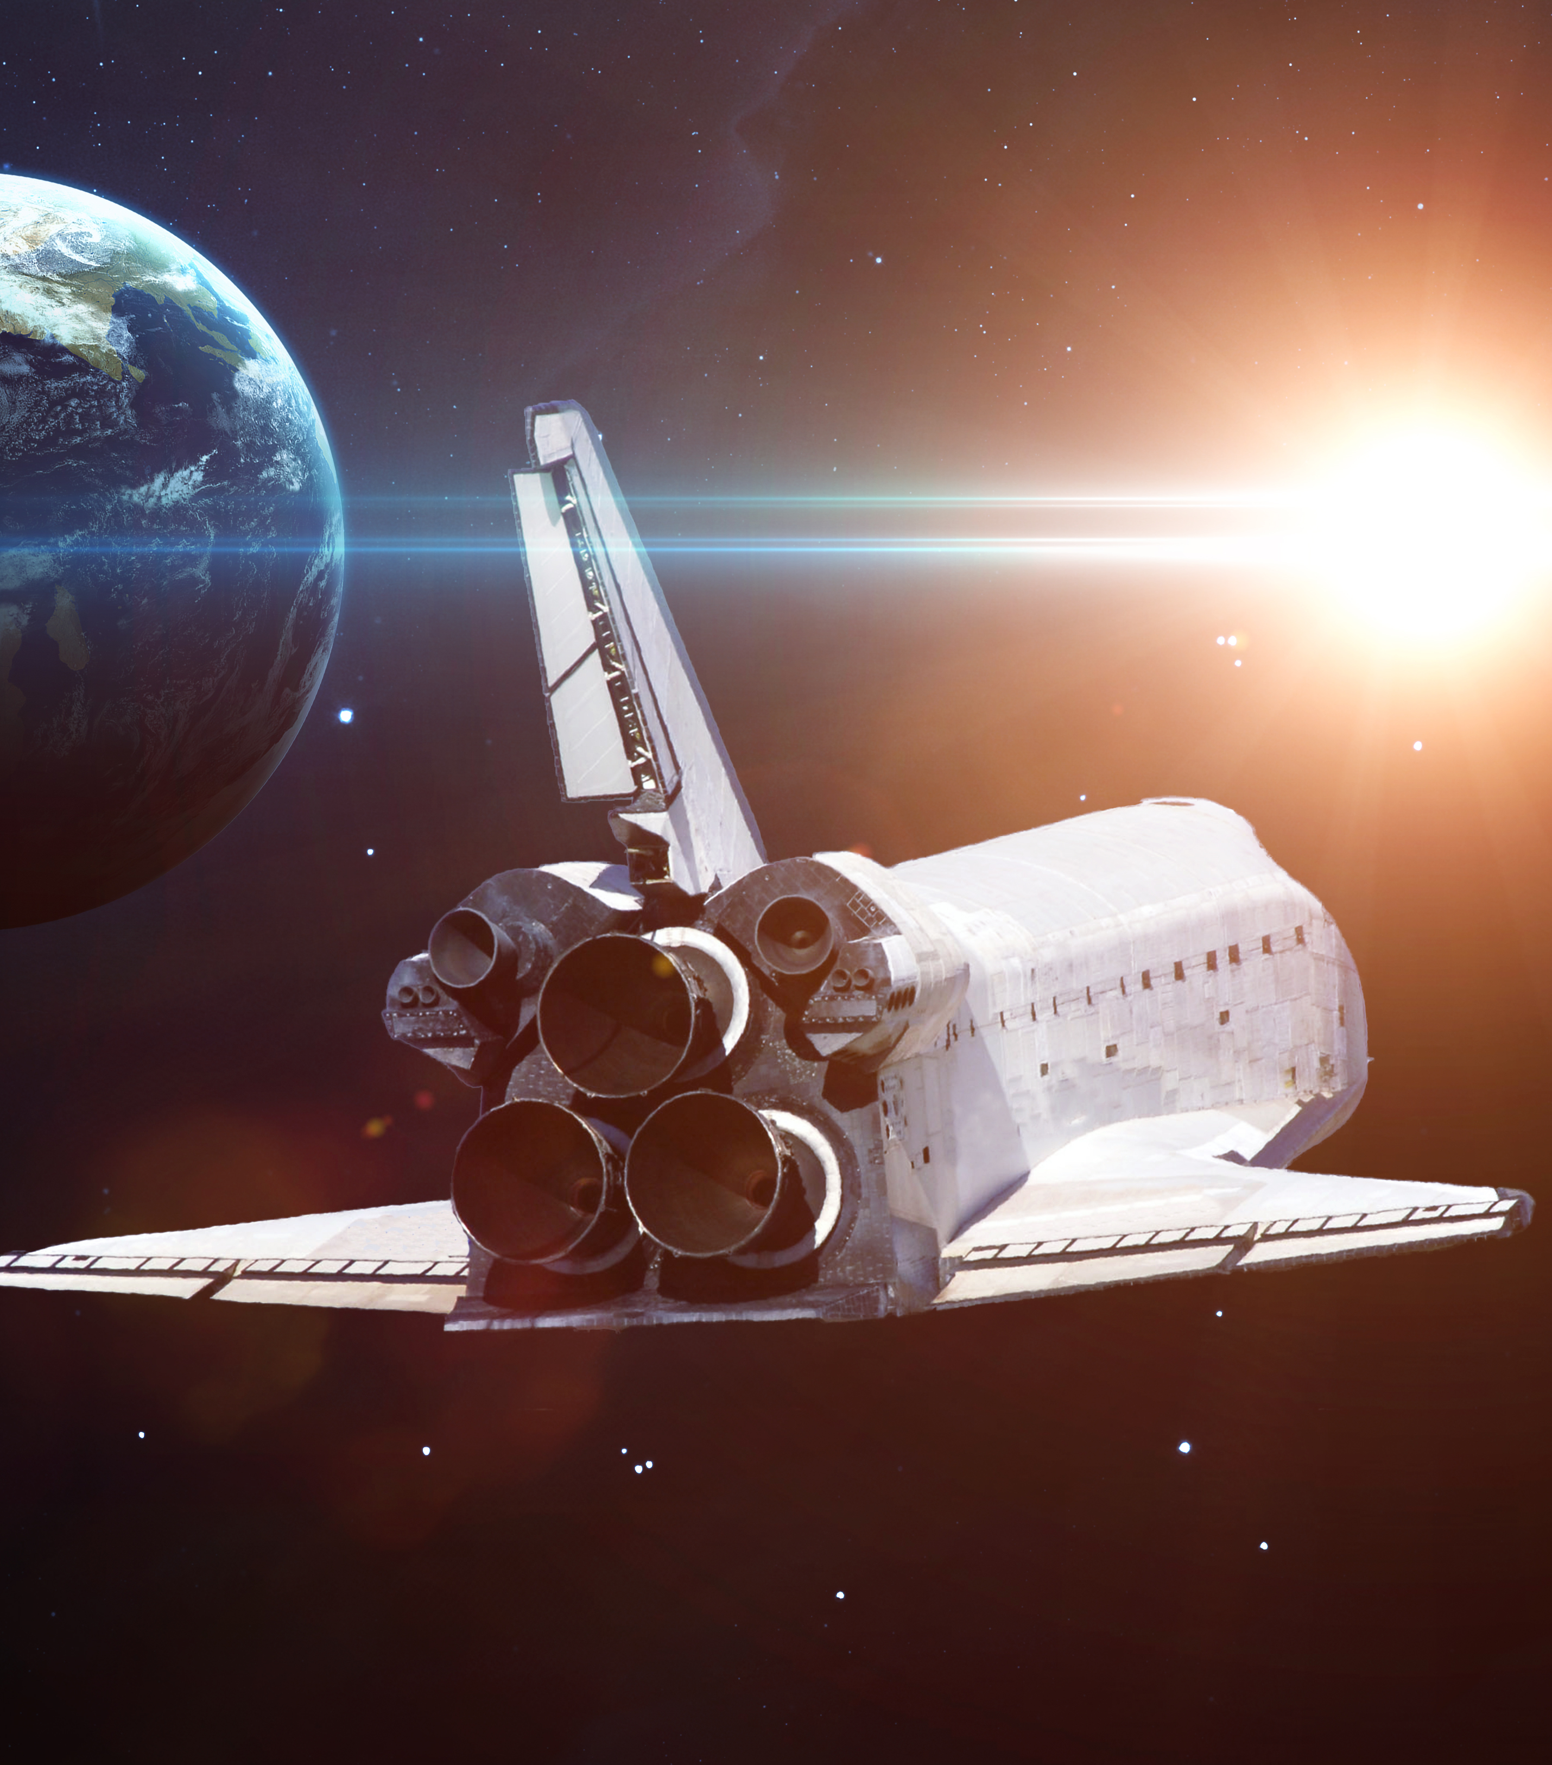
SCALING TESTS WITH DOCKER
LECTURE 12

Slide 2

LECTURE OUTLINE
Topic 1.
Hand free automation strategy
1
Topic 2.
Some common setups
2
Topic 3.
The setup we need
3
Topic 4.
Infrastructure as Code
4
Topic 5.
Enter Docker
5
Topic 6.
More about Docker
6

Slide 3
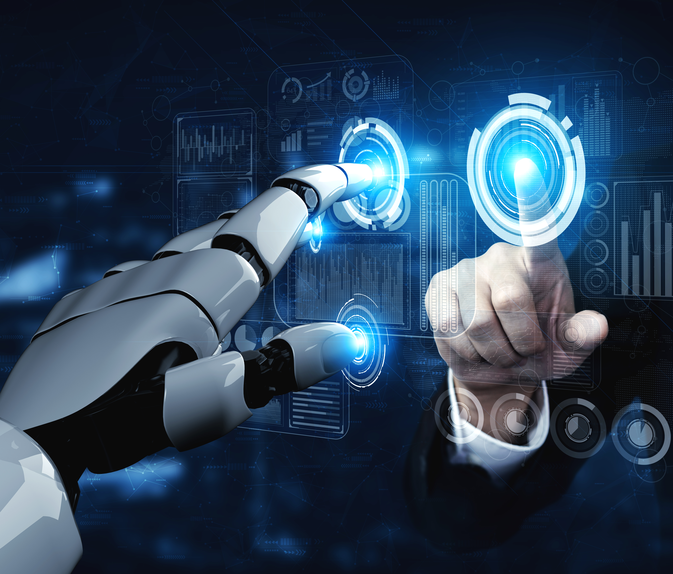
HANDS FREE AUTOMATION STRATEGY
A way of designing a testing solution so that there is no or as little manual intervention as possible, from the beginning to the end of the automation testing cycle i.e. from setting up the test environment to reporting and backing up the test results.

Slide 4
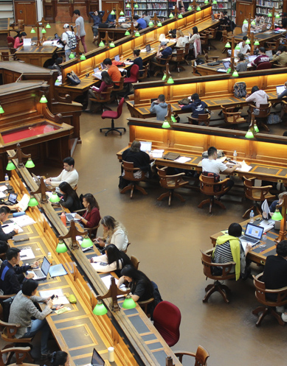

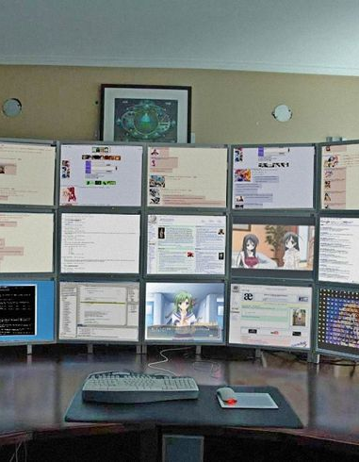
COMMON SETUPS FROM BEGINNERS
A. Setting the environment locally and executing the tests directly from IDE
B. Setting a shared environment but there are specific people who can do it
C. Installation of the app under test is automated but there is the dependencies need to be installed by hand
This Photo by Unknown Author is licensed under CC BY-NC-ND

Slide 5

The setup we need
We need to free our hands and unlock total automation.
[Diagrams]
This Photo by Unknown Author is licensed under CC BY-ND

Slide 6
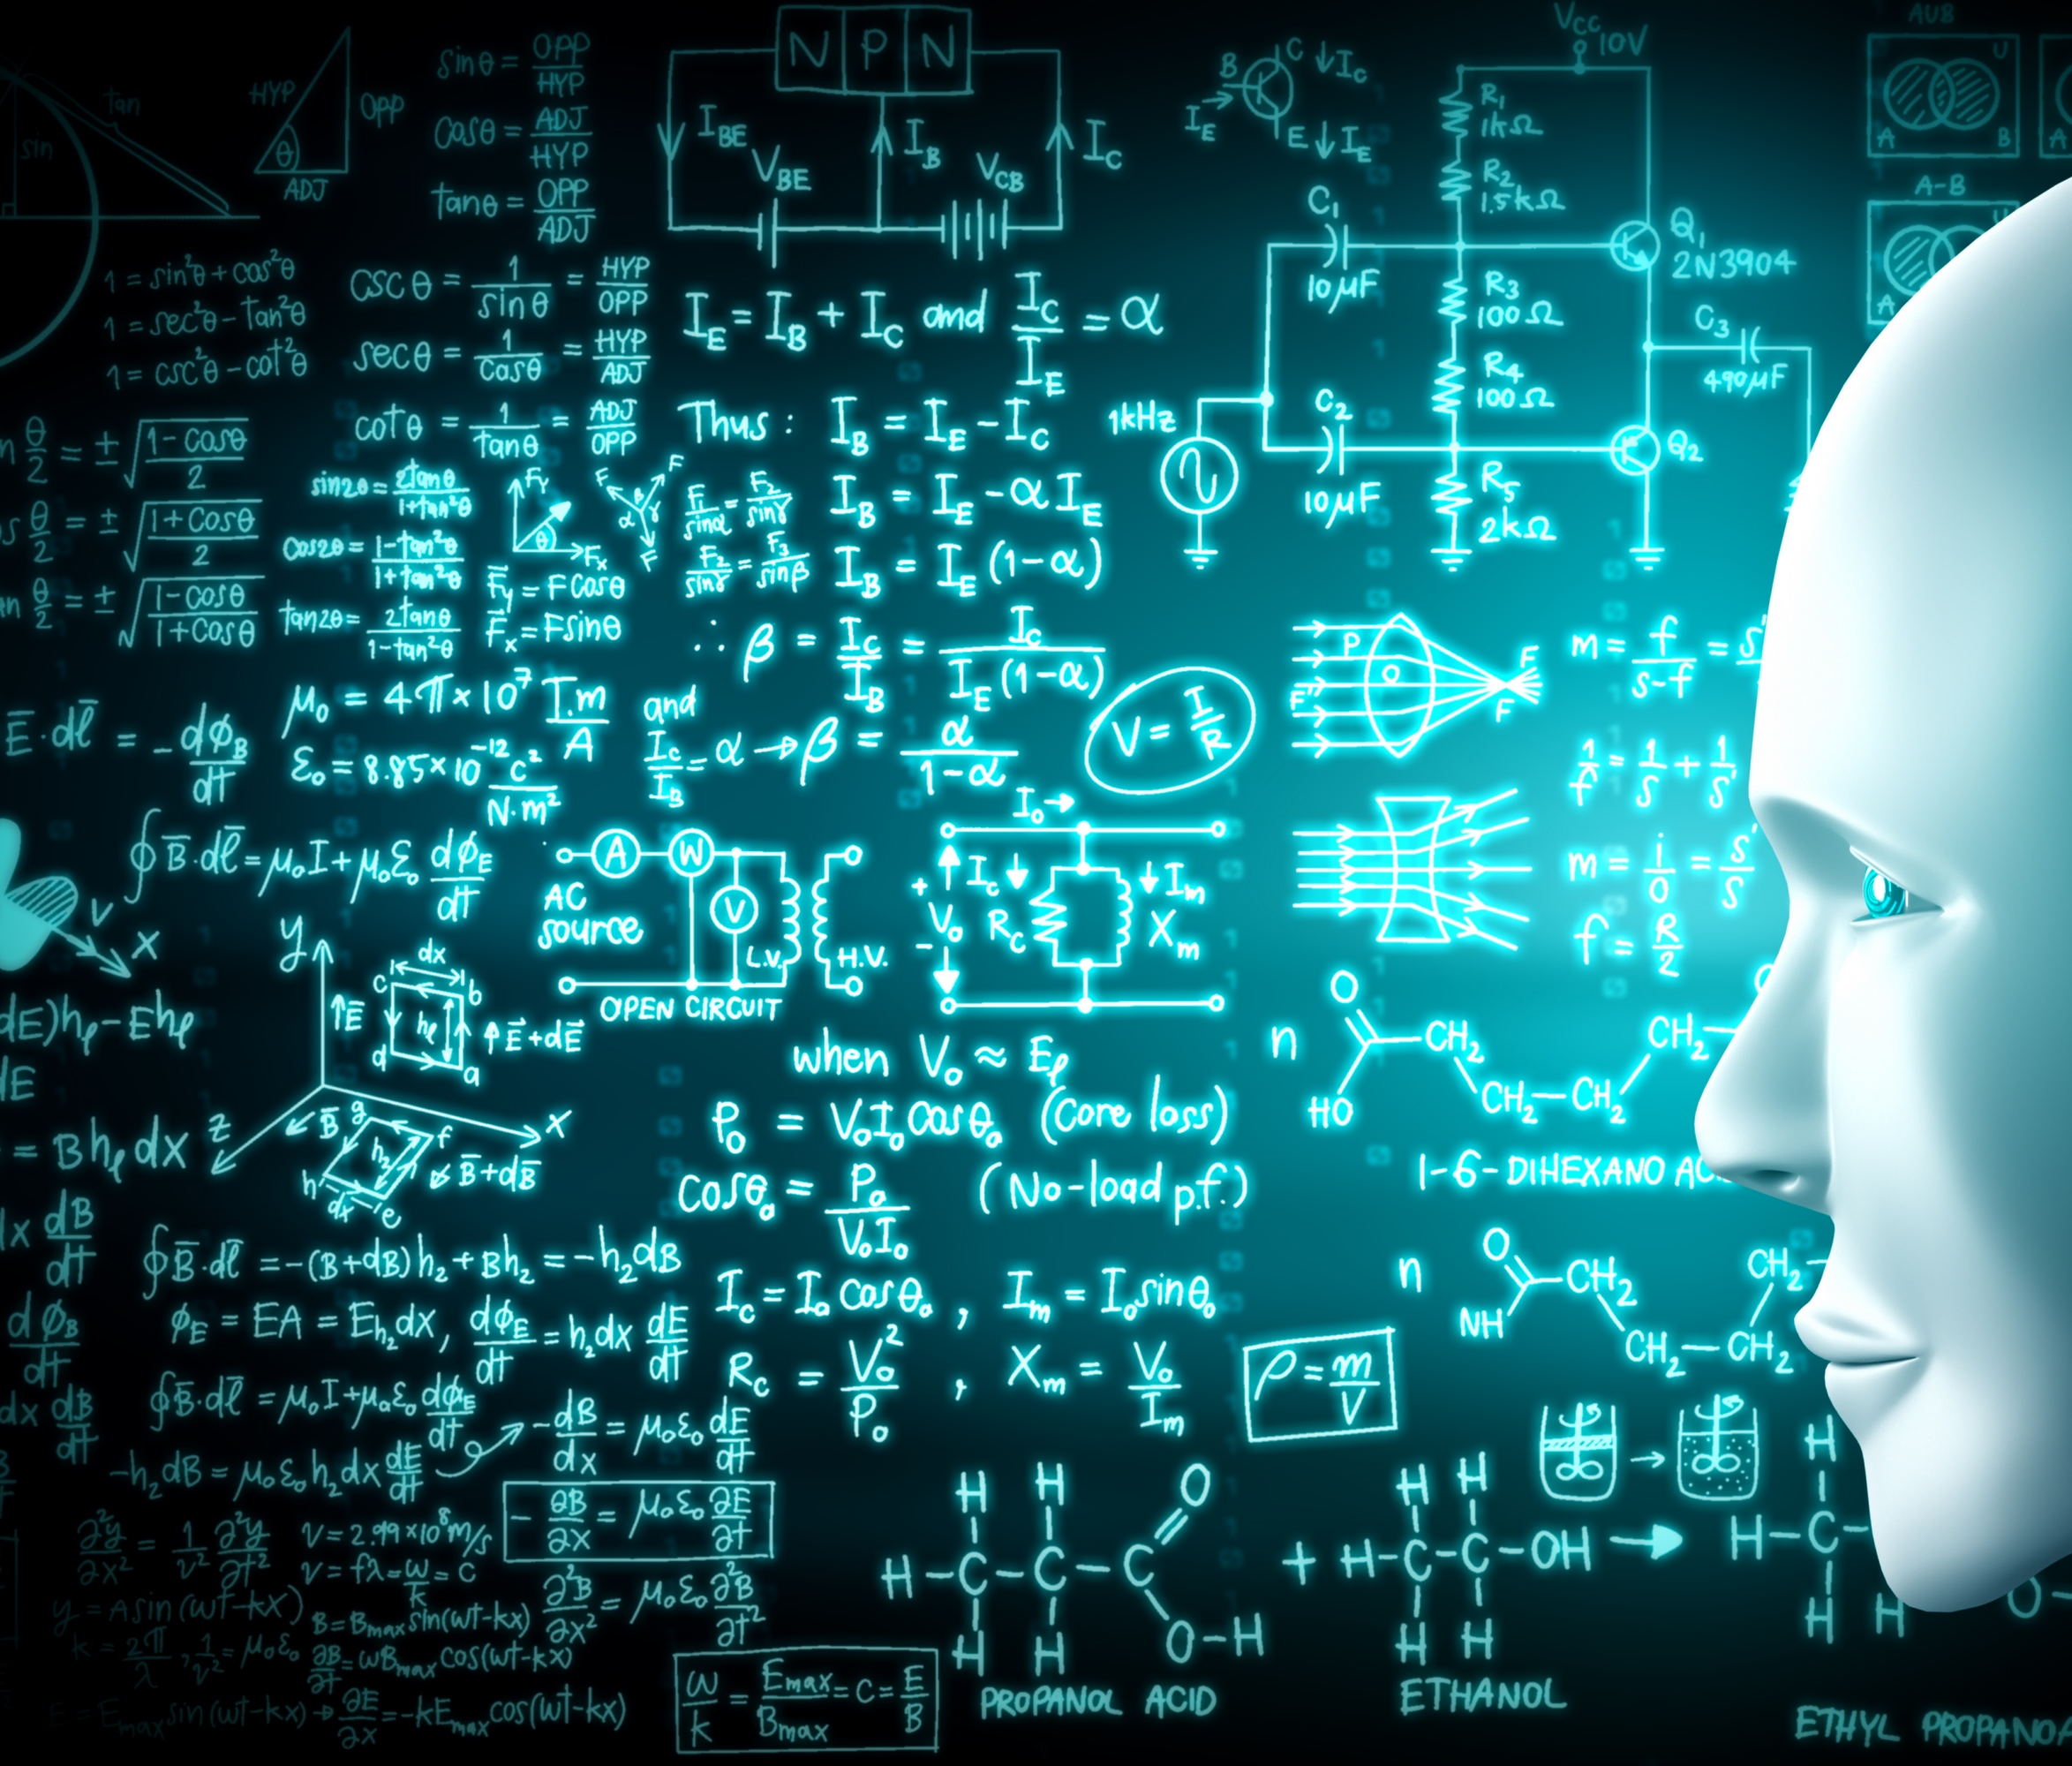
INFRASTRUCTURE AS CODE
Infrastructure as code (IaC) is the process of managing and provisioning computer data centers through machine-readable definition files, rather than physical hardware configuration or interactive configuration tools.

Slide 7

INFRASTRUCTURE AS CODE - MY DEFINITION
Infrastructure as code (IaC) is a way to make your test automation truly portable, repeatable and reliable. It can also give you scalability and robustness if you happen to choose the right tool to do it.

Slide 8

TOOLS THAT HELP WITH INFRASTRUCTURE AS CODE
Terraform
AWS Cloud Formation
Ansible
Chef/puppet
Docker

Slide 9

ENTER DOCKER
The story you may have heard…
How was the transportation industry revolutionized by containers?
https://mccontainers.com/blog/the-history-of-containers/
This Photo by Unknown Author is licensed under CC BY-SA-NC

Slide 10

DOCKER BASICS
Docker uses namespaces and control groups to isolate a piece of you virtual and physical space [Diagrams]
The definition for each piece is stored in Docker files
Docker compose helps you combine several images into a single piece

Slide 11
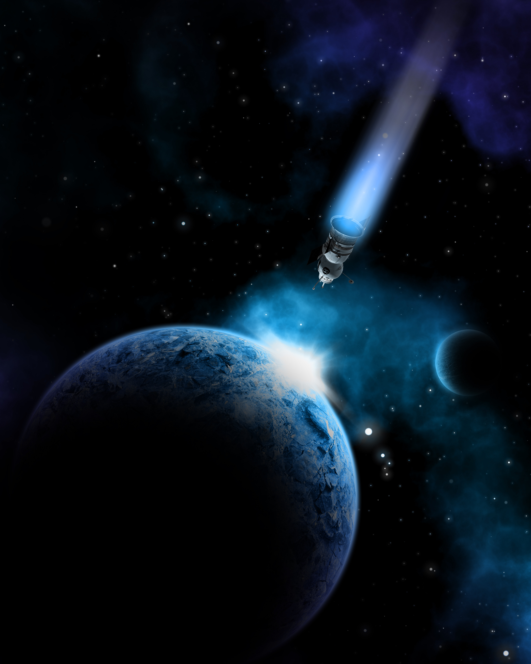

WHAT DOCKER CAN PROVIDE?
Unified environments. test -> dev -> production
Building block for scalable services
Repeatability and automation via IaC
Isolation for each service

Slide 12
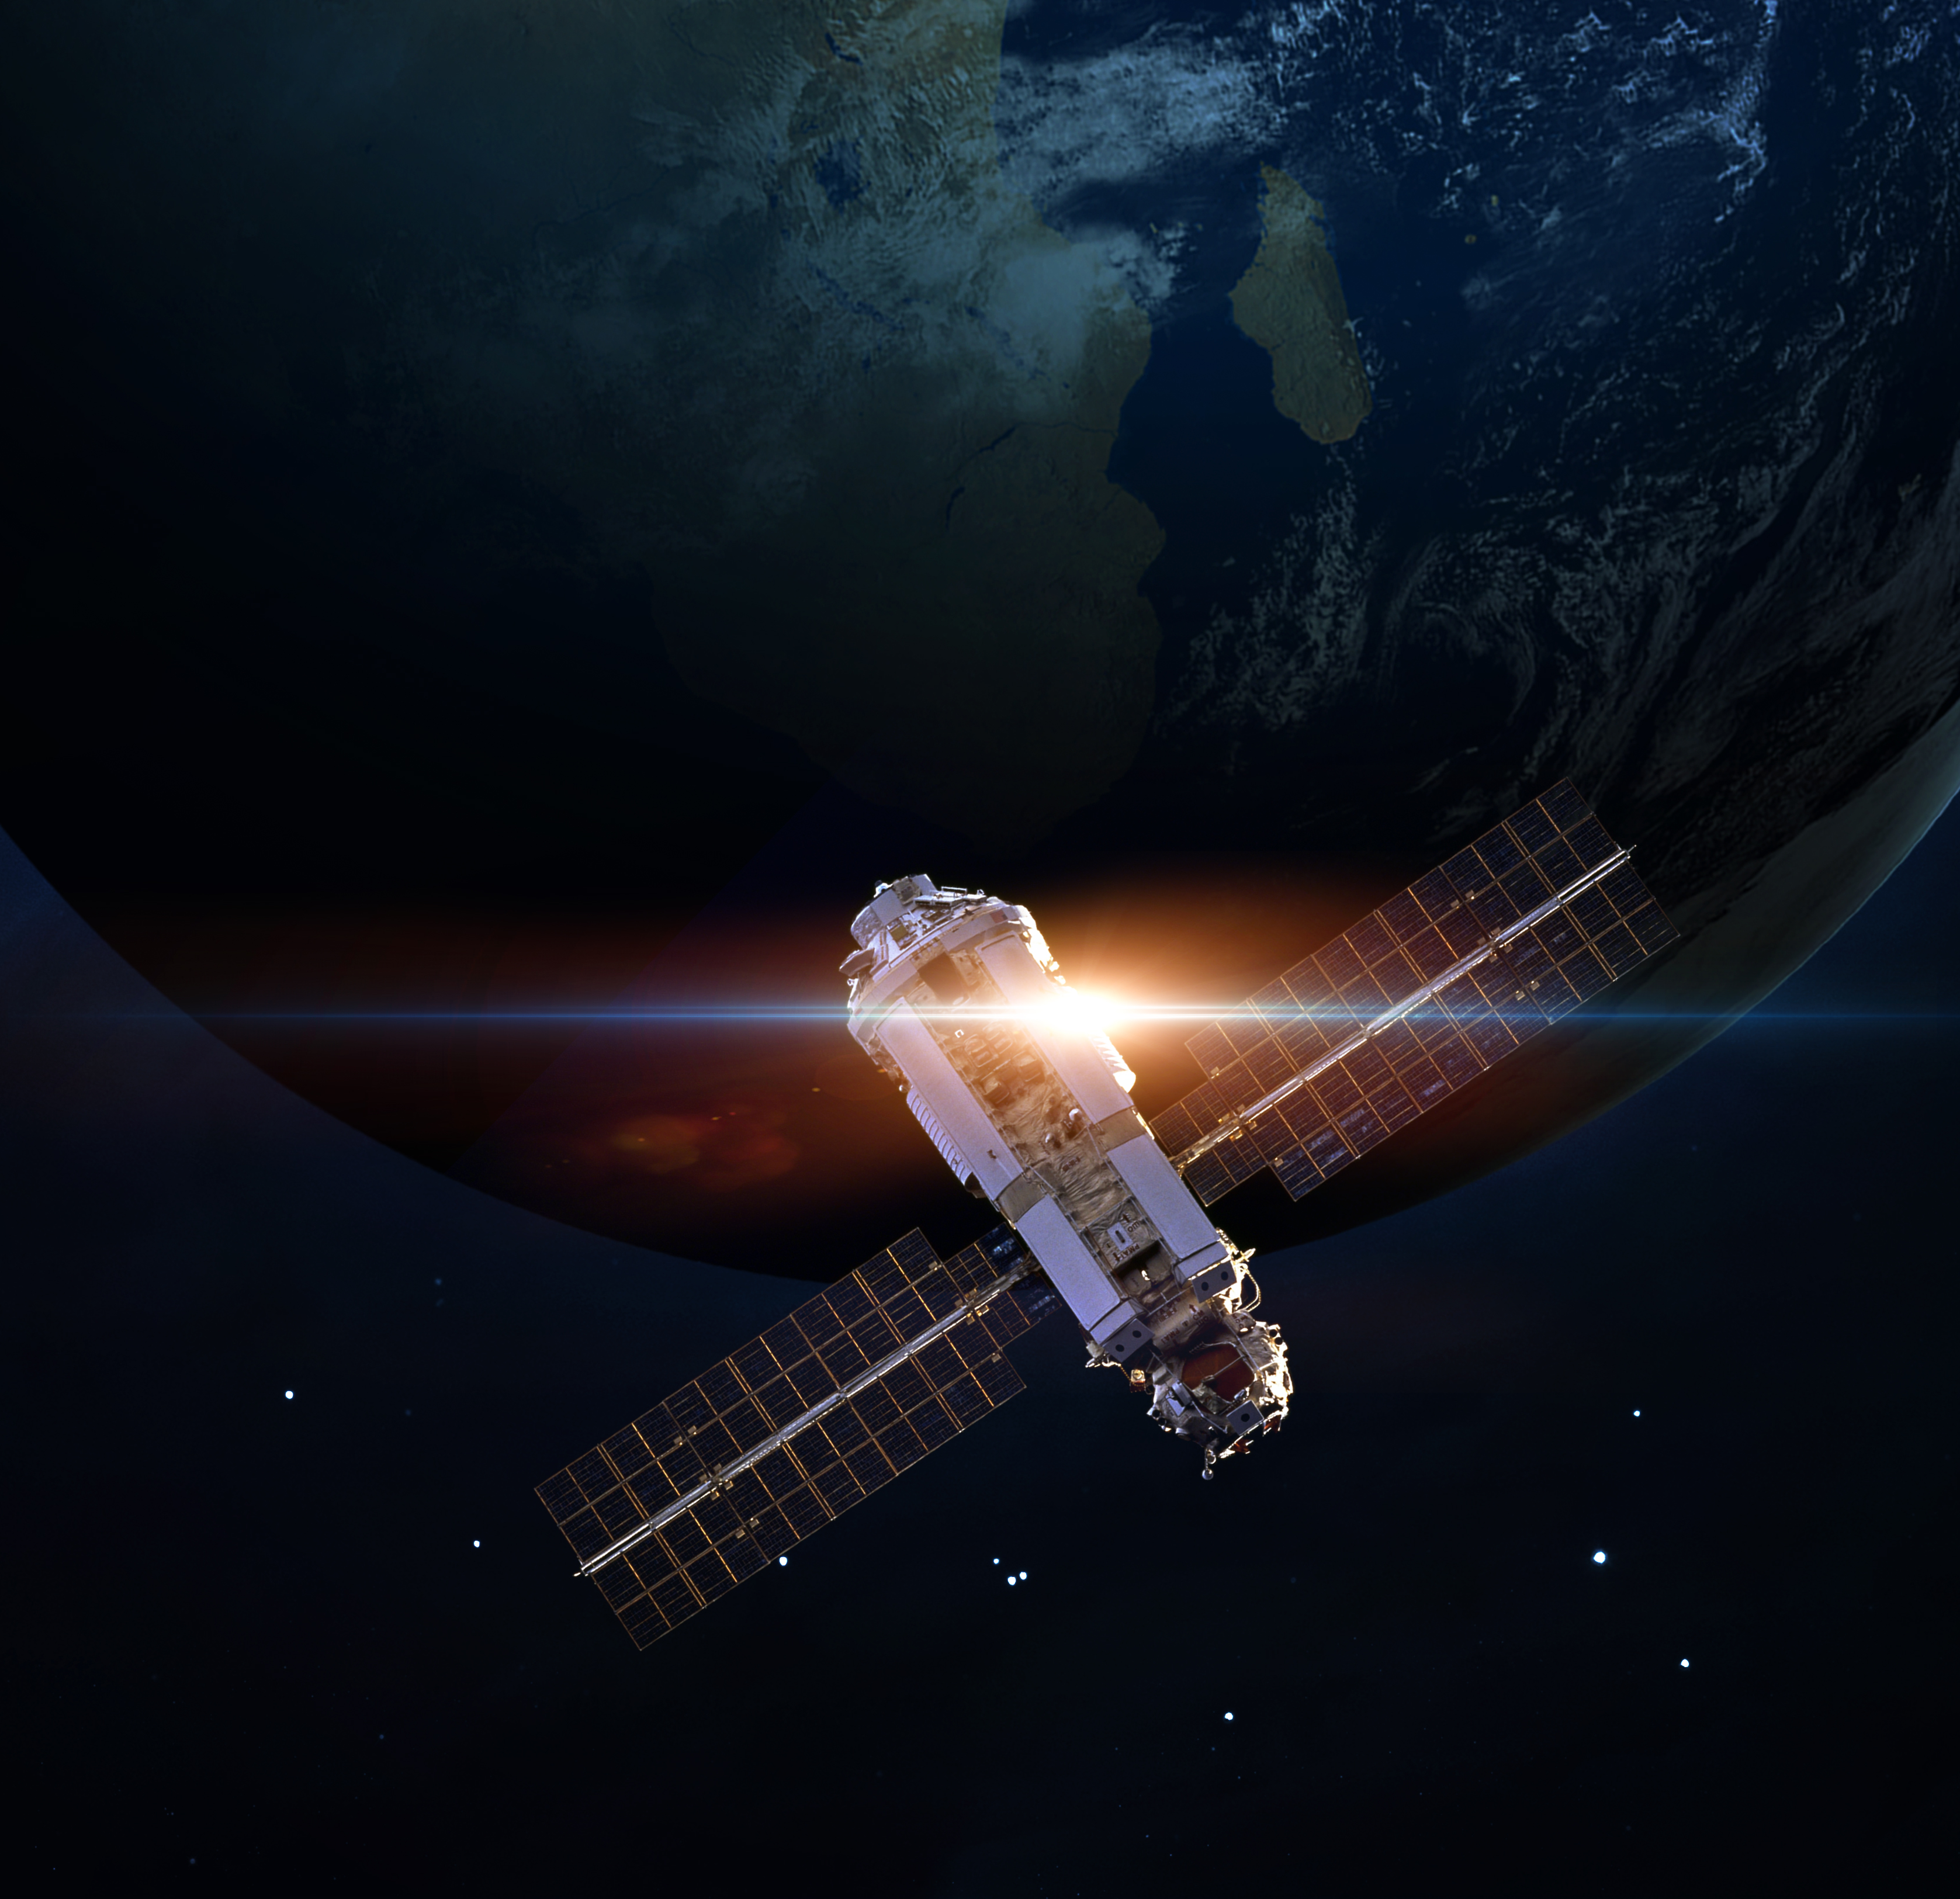
WHAT ELSE DOCKER CAN PROVIDE?
Portable deployment of applications
Support for automatic building of Docker images
Built-in version tracking
Registry for sharing images
A growing tools ecosystem from the Docker API
Consistency among different environments
Efficient utilization of resources

Slide 13

HOW DOCKER CAN BE USED IN TEST AUTOMATION?
Testing solutions are increasing in complexity the same way the systems under test are changing
With complexity of setting up the environment increasing, it is not uncommon to face issue repeating the same test
Some tests need scaling of services e.g. multiple browsers, multiple load generators etc.

Slide 14
Docker vs (Ansible + Chef + Terraform)
Docker is a containerization tech that isolates small pieces of your application and wraps them up into a fully functional scalable service
Helps to effortlessly break down a machines resources into smaller units and makes them available as dynamically available units.
It can help with achieving IaC or hands-free automation
It has cherry on the cake.
Ansible or Chef or Terraform automate the infrastructure, dependency and application installation
They just help how setup a machine
It can help with achieving IaC or hands-free automation as well
We can call them either cherry or cake. Not both. ☺

Slide 15
THANK YOU!

